Slide 1

ECE2050 Digital Logic and Systems Tutorial 1
Huaiyu Li
223010059@link.cuhk.edu.cn
2025.01

Slide 2
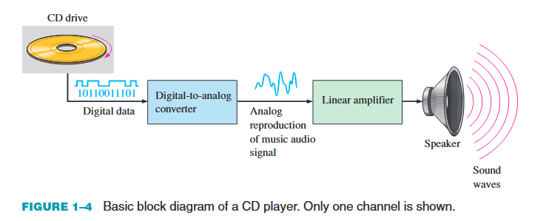
Review Analog & Digital Signal
Q1: Differences between digital & analog quantities?
A1: 1. analog: natural, continuous, infinite;
2. digital: finite, discrete.
Q2: Advantages of digital signal?
A2: 1. process, store, and transmit data more efficiently and reliably;
2. noise-resistant
Applications:
Digital: CPU GPU DSP MCU SoC ASIC FPGA
Analog: Power supply ADC DAC Interface

Slide 3
Review Pulse waveform
1. Rise time: The time required for a pulse to go from its LOW level to its HIGH level. (common to measure from 10% to 90% of amplitude)
2. Fall time: the time required for the transition from the HIGH level to the LOW level. (common to measure from 90% to 10% of amplitude)
3. Pulse width: a measure of the duration of the pulse. (often defined as the time interval between the 50% points on the rising and falling edges)
4. Amplitude: the magnitude or intensity of the signal waveform measured in volts or amps
5. Frequency: the rate at which it repeats itself and is measured in hertz (Hz)..
6. Period: the length of time that the waveform takes to repeat itself from start to finish
7. Duty cycle: the ratio of the pulse width (𝑡𝑊) to the period (T).

Slide 4
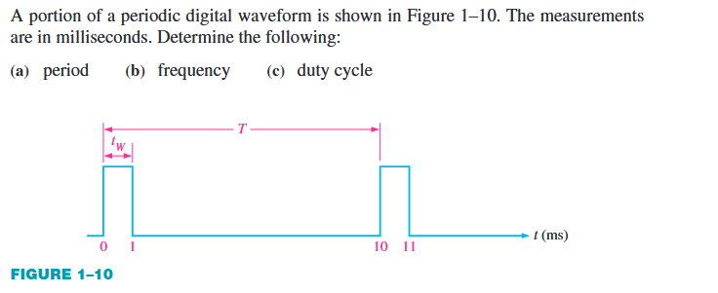
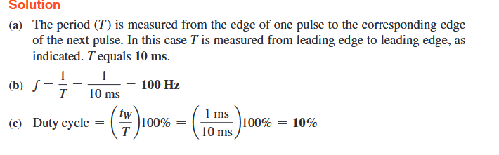
Review Pulse waveform
Q3:
A3:

Slide 5
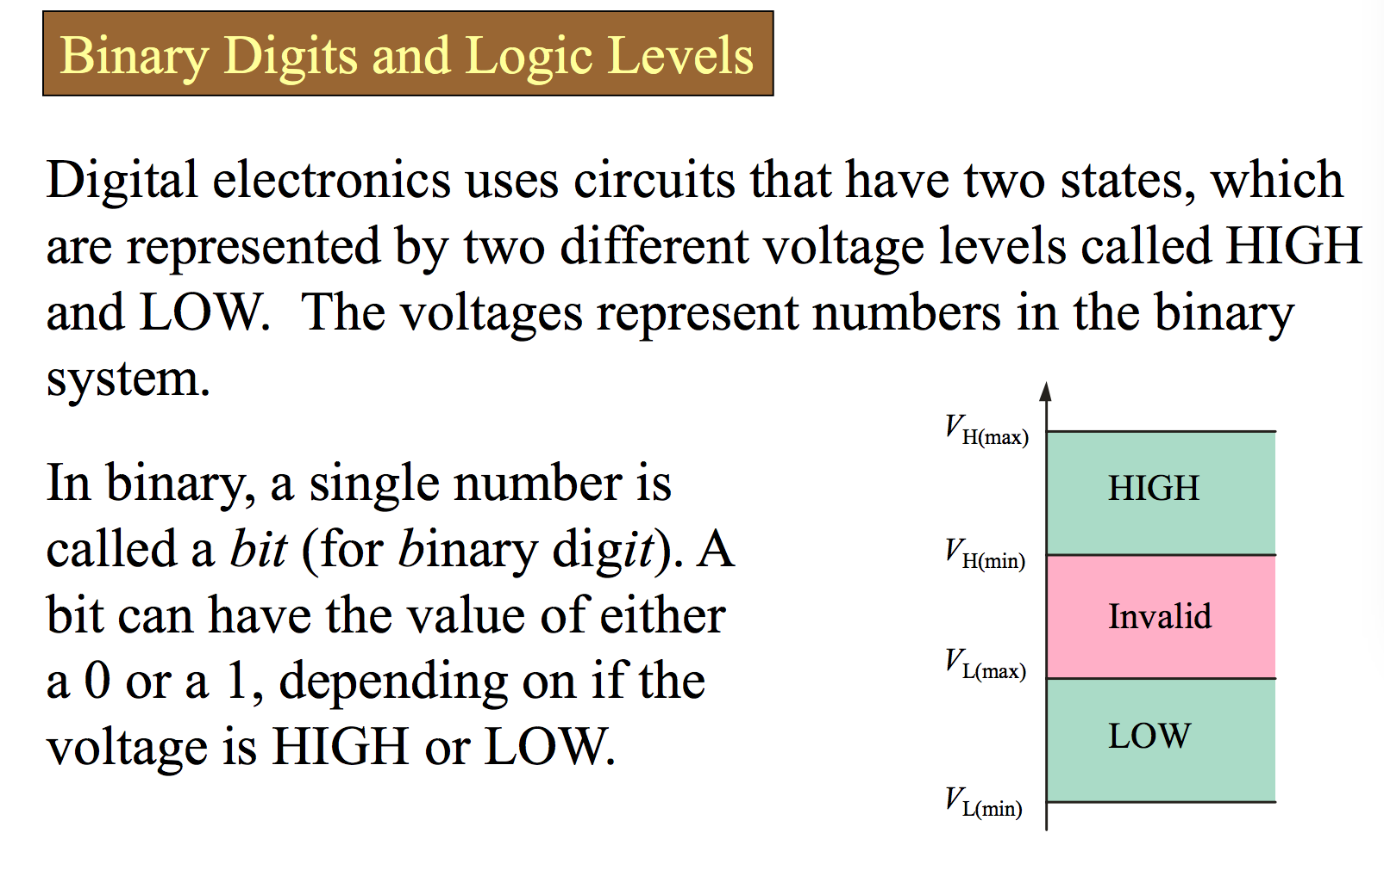
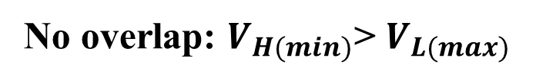
Review Binary Values
No overlap: $V_{H(min)}$> $V_{L(max)}$

Slide 6
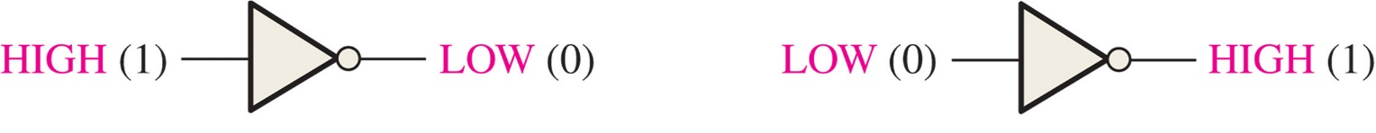
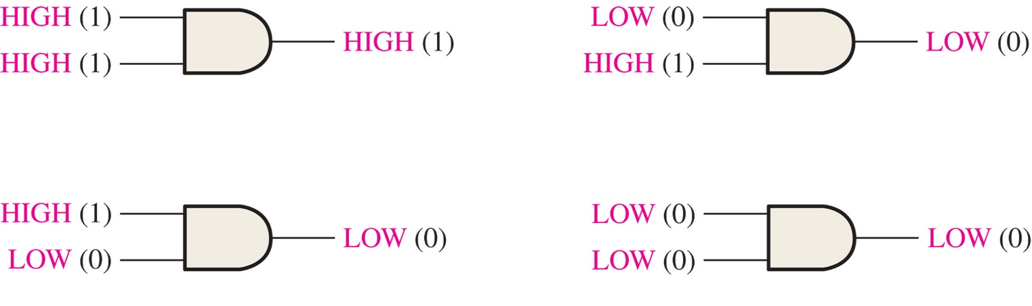
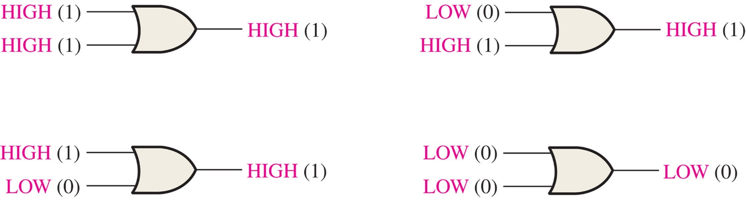

Basic Logic Functions of NOT, AND, and OR
Logic gate : A circuit that performs a specified logic function
NOT
A---$\overline{A}$
A·B
AND
OR
A+B

Slide 7
Number system and Some Basic Units
Decimal | Binary | Octal | Hex
0 | 0000 | 00 | 0
1 | 0001 | 01 | 1
2 | 0010 | 02 | 2
3 | 0011 | 03 | 3
4 | 0100 | 04 | 4
5 | 0101 | 05 | 5
6 | 0110 | 06 | 6
7 | 0111 | 07 | 7
8 | 1000 | 10 | 8
9 | 1001 | 11 | 9
Decimal | Binary | Octal | Hex
10 | 1010 | 12 | A
11 | 1011 | 13 | B
12 | 1100 | 14 | C
13 | 1101 | 15 | D
14 | 1110 | 16 | E
15 | 1111 | 17 | F

Slide 8
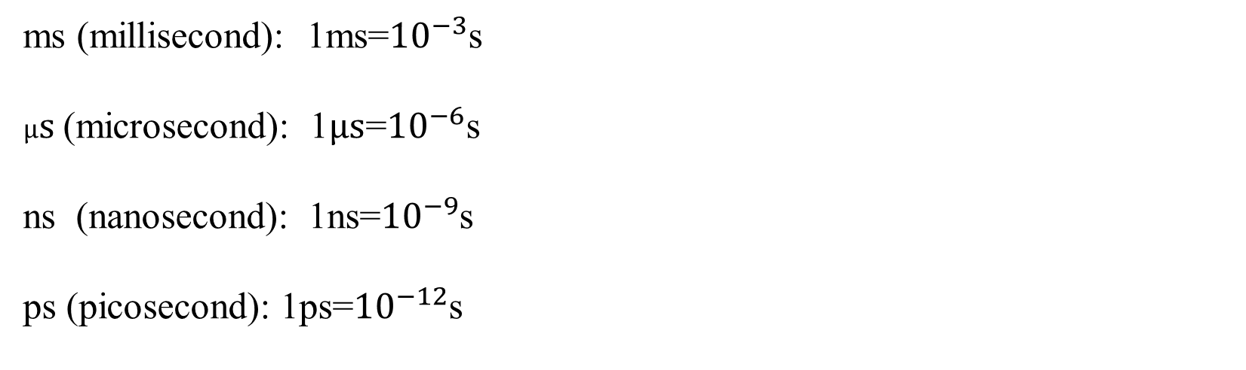
Number system and Some Basic Units
ms (millisecond): 1ms=${10}^{−3}$s
$μs$(microsecond): 1$μs$=${10}^{−6}$s
ns (nanosecond): 1ns=${10}^{−9}$s
ps (picosecond): 1ps=${10}^{−12}$s

Slide 9
Q&A

Slide 10
Thank You!

